Slide 1
BIG DATA (X-LARGE)
WSDM – KKBox’s Music Recommendation Challenge

Slide 2
LANGUAGES

Slide 3


LANGUAGES
R is an open source programming language and software environment for statistical computing and graphics that is supported by the R Foundation for Statistical Computing.
The R language is widely used among statisticians and data miners for developing statistical software and data analysis.
[reference] https://www.kaggle.com/pallabs/pallab-sarkar-kkbox-music-recommendation-eda-i

Slide 4


LANGUAGES
Python is powerful and fast; plays well with others; runs everywhere; is friendly & easy to learn; is Open.
Python is developed under an OSI-approved open source license, making it freely usable and distributable, even for commercial use. Python’s license is administered by the Python Software Foundation.
Python can be used in multi-object (productivity), uses other languages’ functions (versatility), possesses rich ecosystem of community(combination) , and has openness.
[reference] https://www.Kaggle.com/bellar/basic-eda/notebook

Slide 5
R

Slide 6
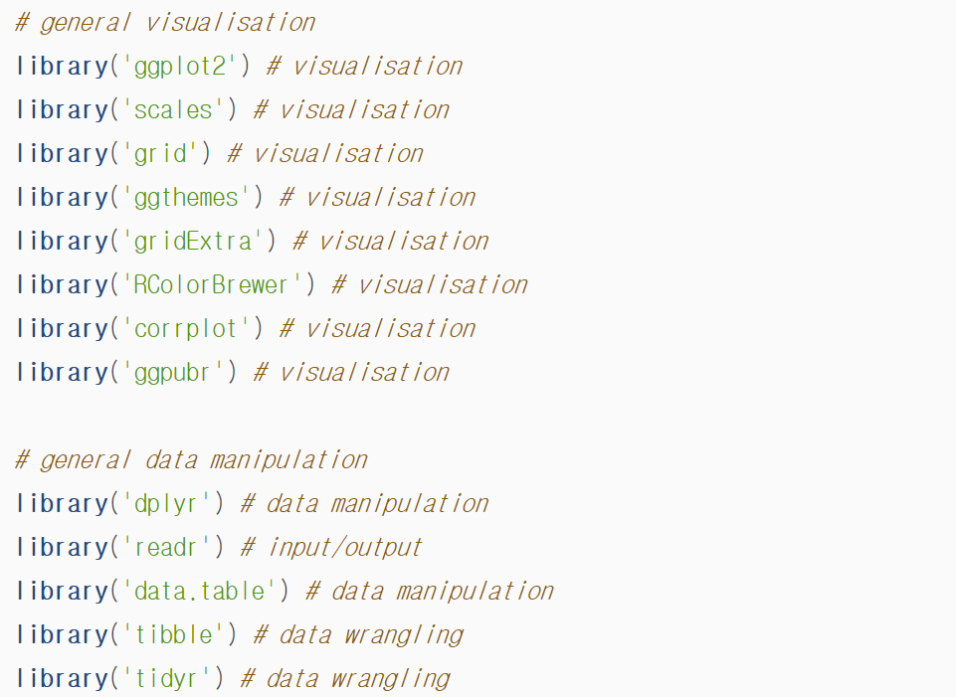
Load Libraries

Slide 7
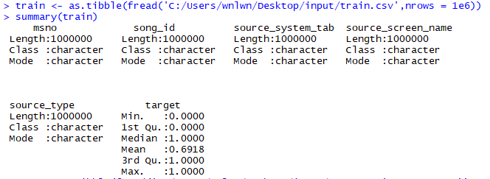
Load Data
Problem : How we are going to deal with large data. We need GPU!

Slide 8
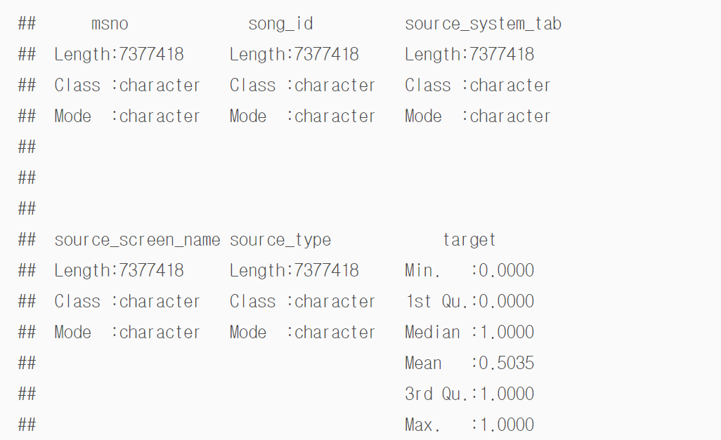
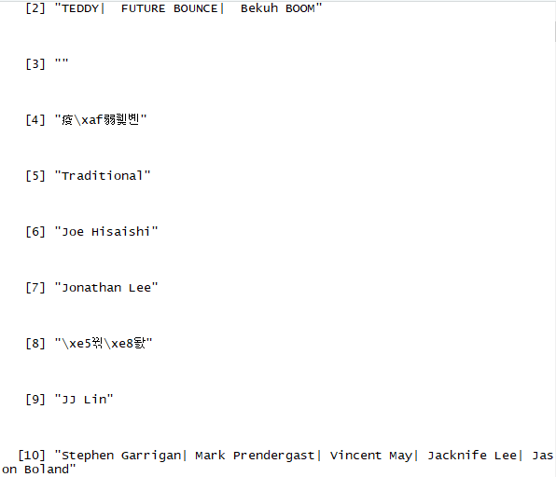
Data Summary
Summary(train)
Unique(songs$composer)

Slide 9
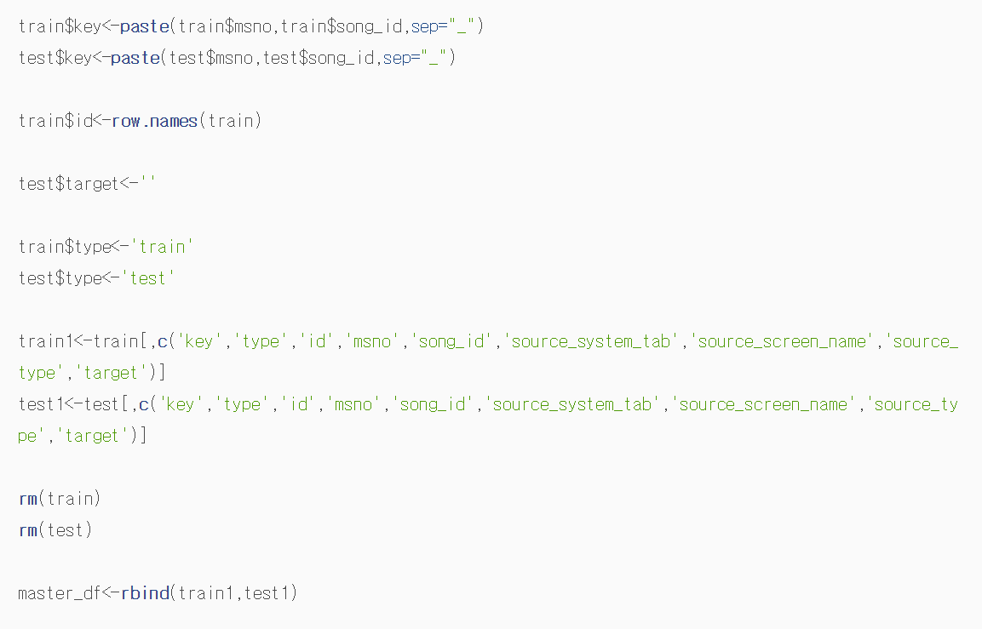
Data Manipulation

Slide 10
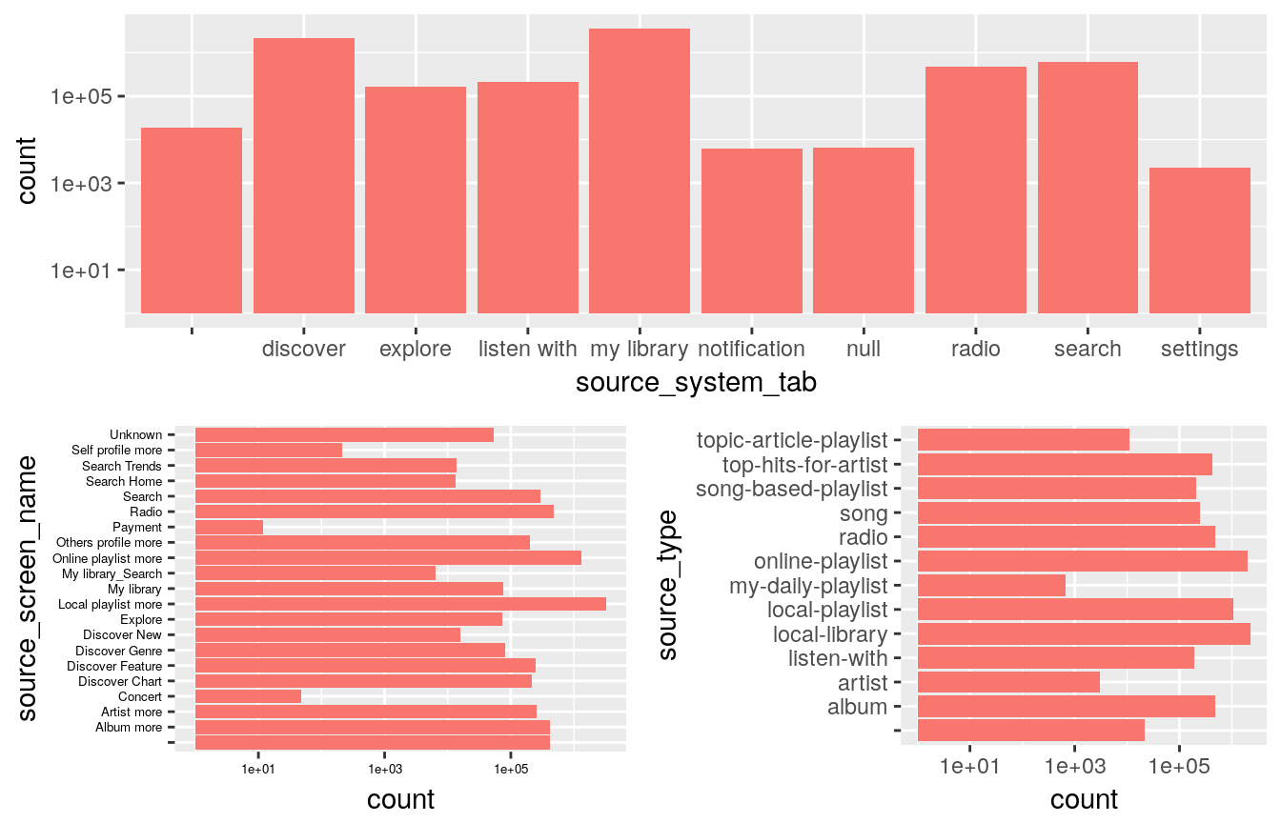
Data Visualization

Slide 11
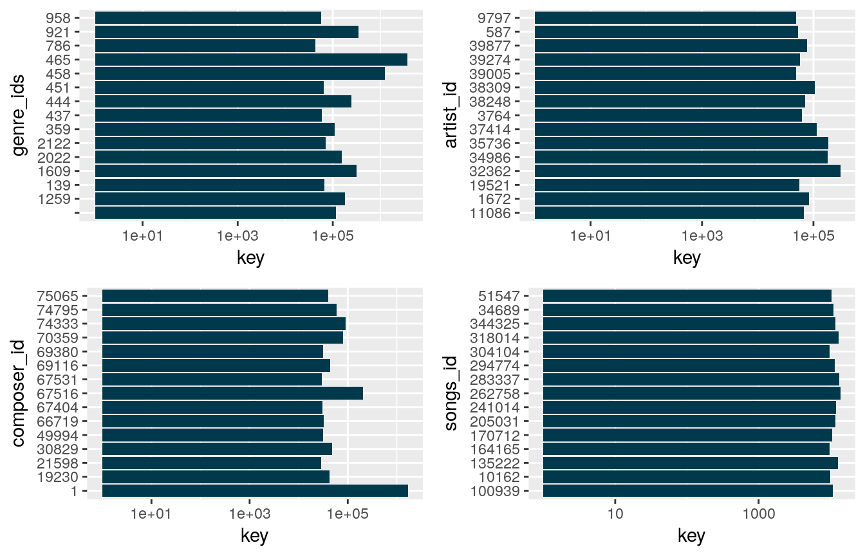
Data Visualization

Slide 12
PYTHON

Slide 13
LIBRARYIES
numpy
pandas
Matplotlib.pyplot
seaborn
A library that plays a key role when used in computational science
Provides detailed information processing functions and functions related to matplotilb graphic output
Modules that provide functionality similar to the MATLAB plotting system
Python visualization library based on Matplotlib
Provides high-performance multidimensional array objects and tools to handle them
Widely used for data munging and preparation for structured data manipulation and manipulation
Show attractive statistical graph

Slide 14
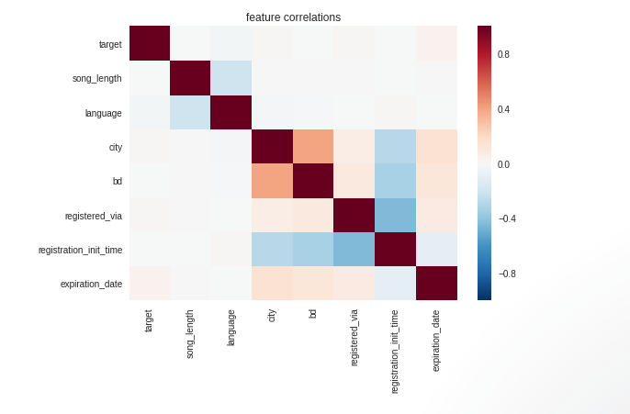
Data Visualization

Slide 15
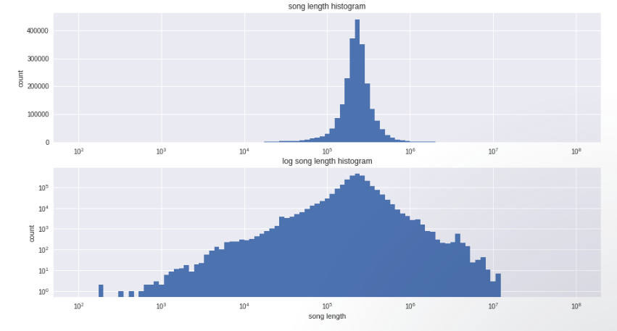
Data Visualization

Slide 16
FEATURES
of DATA

Slide 17
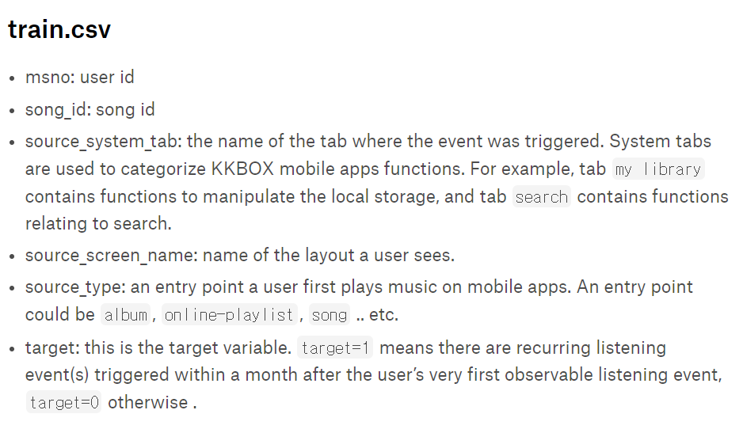
train.csv

Slide 18


train.csv
Source_system_tab:
Discover: show the musics by chart, featured(today’s recommendation), new, genre&mood
Explore: suggest more songs based on listening history (by Genre, Home)
Listen with: listen songs that celebrities or friends recommand
My library: Menu that my playlist is gathered
Notification: notification when some artist’s album is coming out
Radio: listen songs like radio
Search: search songs
Setting: sort songs by filters
Null

Slide 19
train.csv
Source_screen_name:
Unknown
Self-profile-more
Others profile more
Local-playlist-more
My-library-search
My-library
Search-home
Search-trends
Search
Radio
Payment
Explore
Discover new
Discover Genres
Discover Feature
Discover Chart
Concert
Artist more
Album more

Slide 20
train.csv
Source_type:
Topic-article-playlist
Song-based-playlist
Song
Radio
Online-playlist
My-daily-playlist
Local-playlist
Local-library
Listen-with
Artist
Album

Slide 21
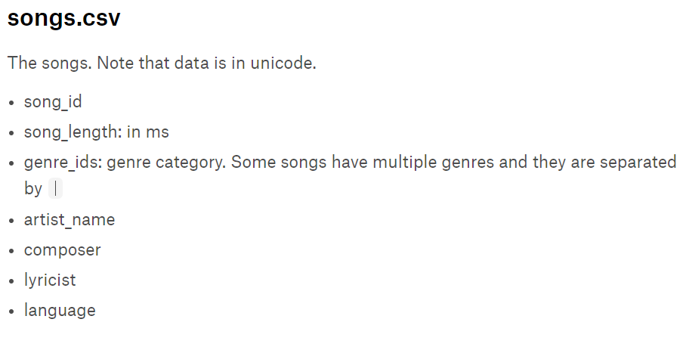
songs.csv
* What about Release date?

Slide 22
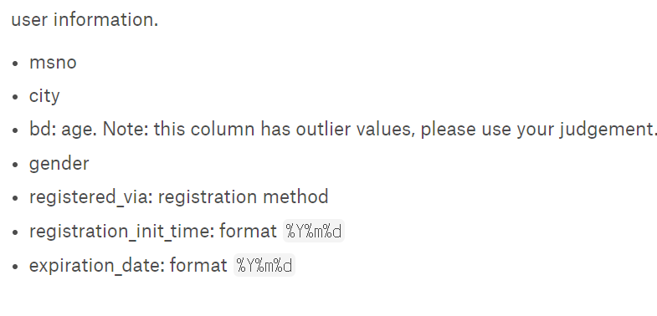
members.csv

Slide 23
THANKYOU
WSDM – KKBox’s Music Recommendation Challenge

